Slide 1
Typescript – Step 8

Slide 2
Typescript
Typescript is a super of JavaScript.
TypeScript offers all of JavaScript’s features, and an additional layer on top of these: TypeScript’s type system. It support data types.
Typescript support all features of oops concept.
Browser typescript can’t understand.
We need to convert ts to js using typescript transpiler.

Slide 3
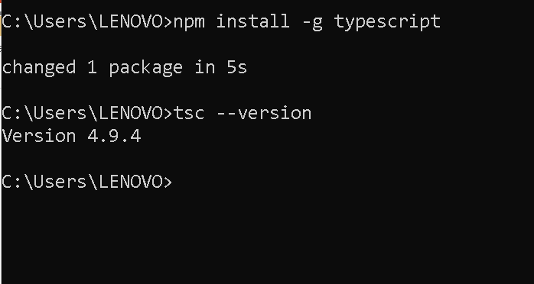
Enable typescript transpiler we need to run the command as

Slide 4
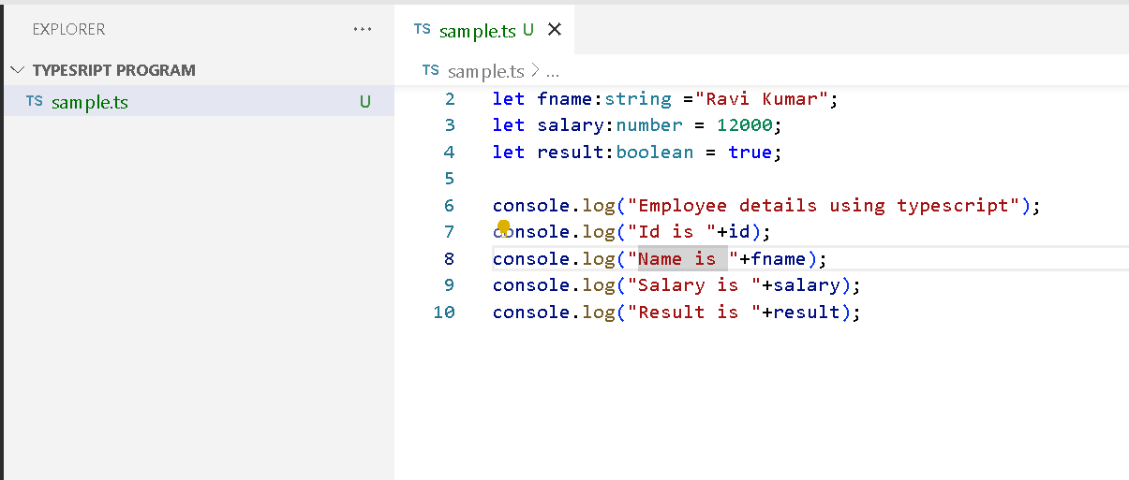
Sample typescript program

Slide 5
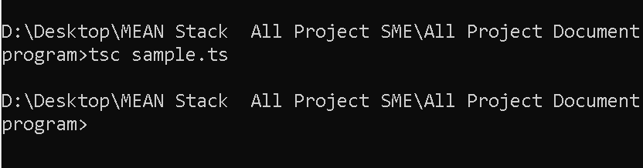
Convert ts to js

Slide 6
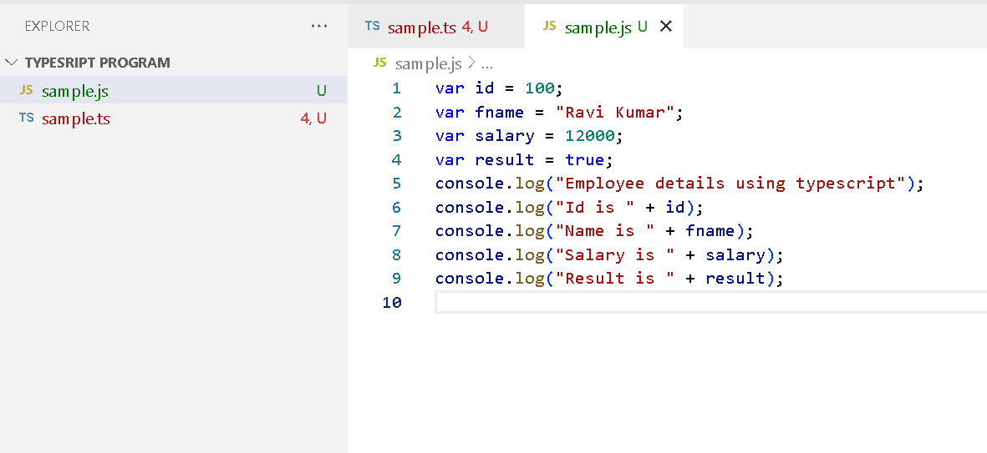
Sample js file converted using tsc

Slide 7
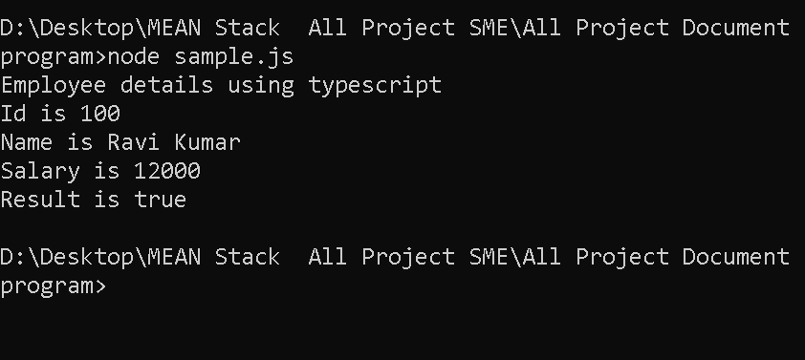
Running js file using node command

